Slide 1
Mini Project on Online Pet Shop
M.Monisha B.E.ECE

Slide 2
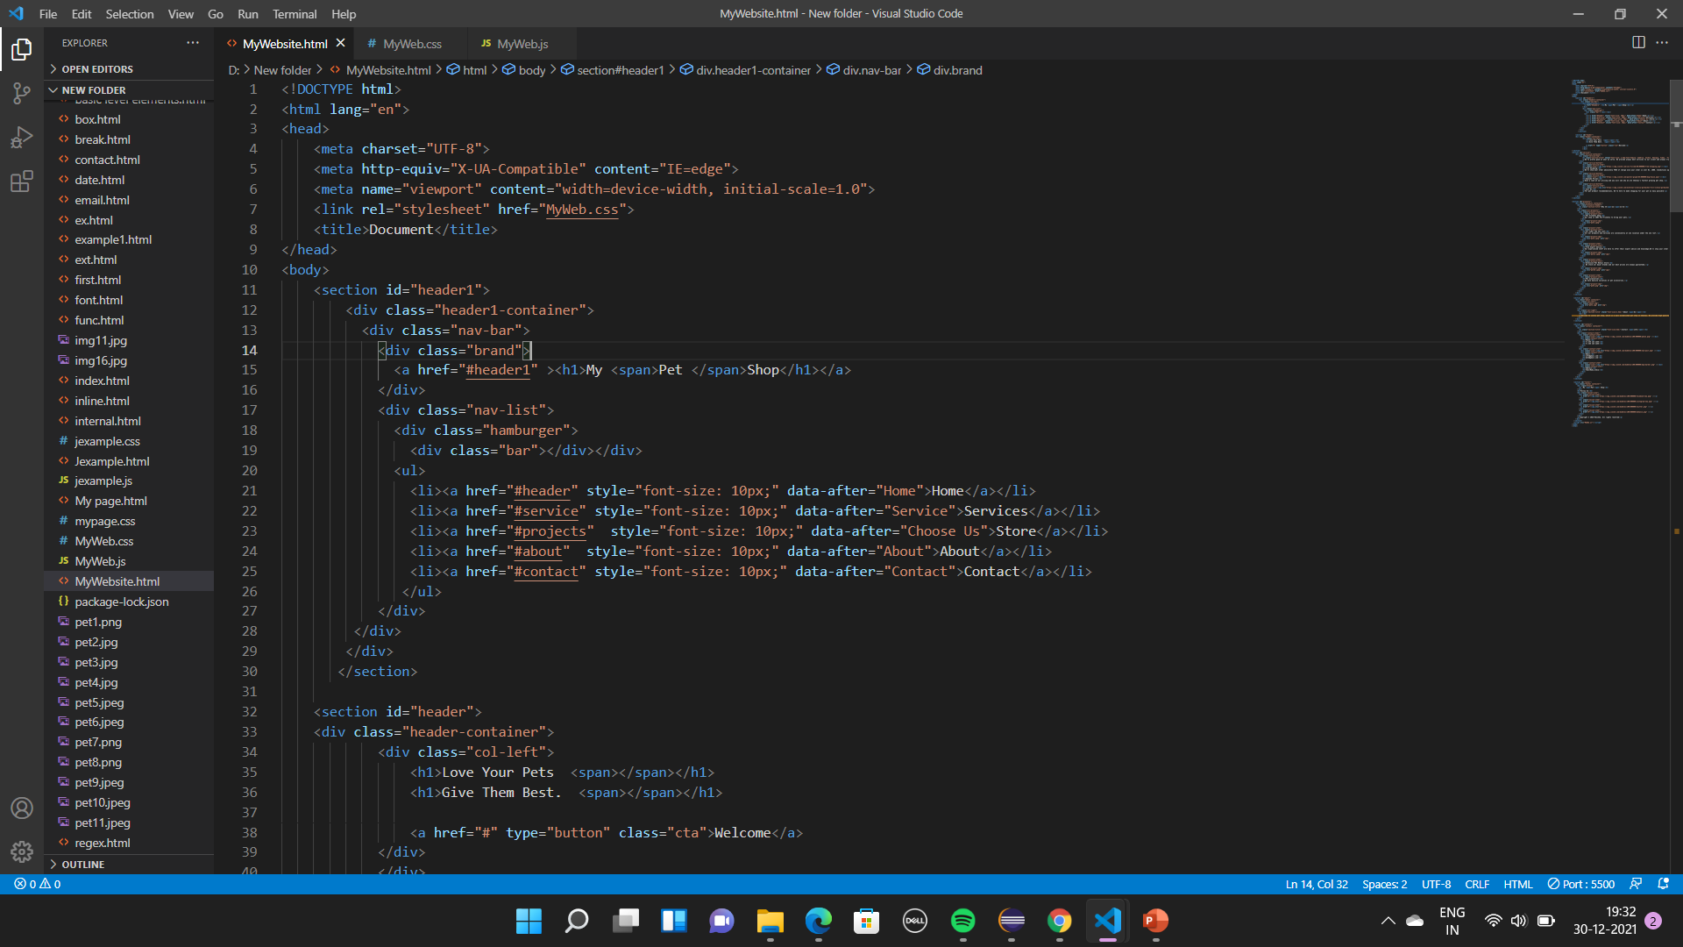
Home Page
It contain welcome page with home, store, about, service & contact sections.

Slide 3
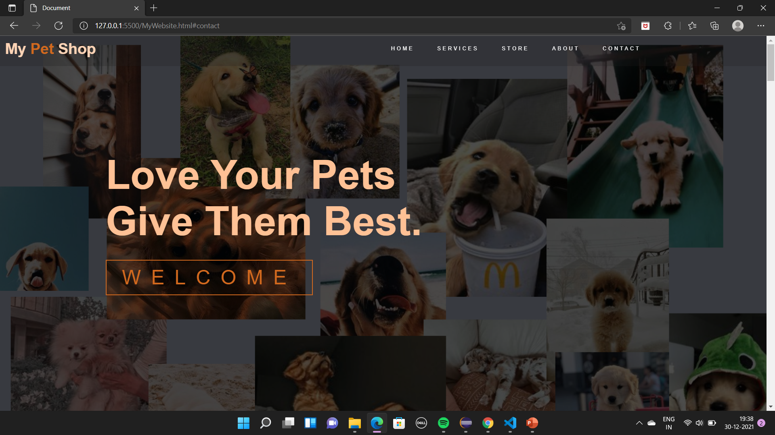
Output Of Home Page

Slide 4
Service Page
Description:
It contains service header and three bottom container which highlights their services.
Free Shipping
Awesome Prices
Call Us

Slide 5
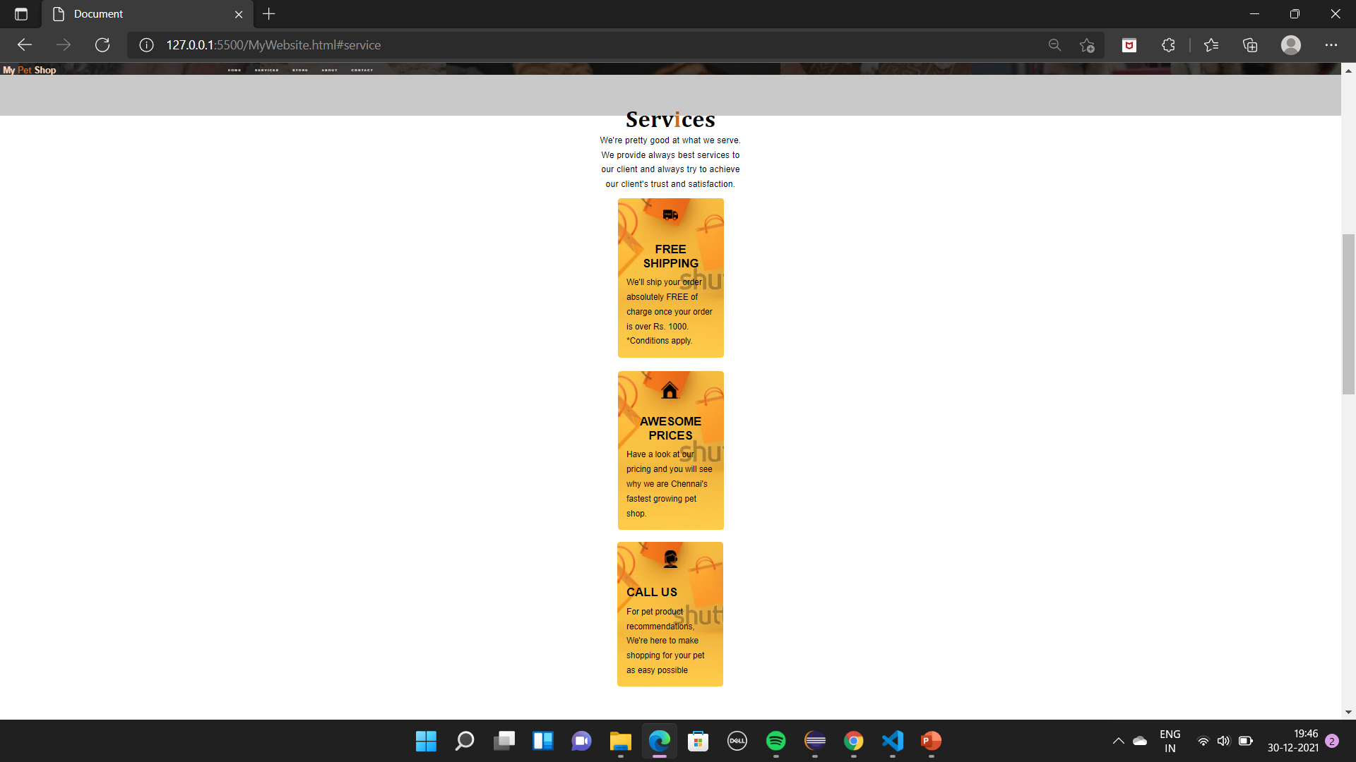
Output Of Service Page

Slide 6
Store Page
Description:
It shows some image list of the store items ( i. e )Pets accessories and foods.
It also include and hightlights their achivements and services.

Slide 7
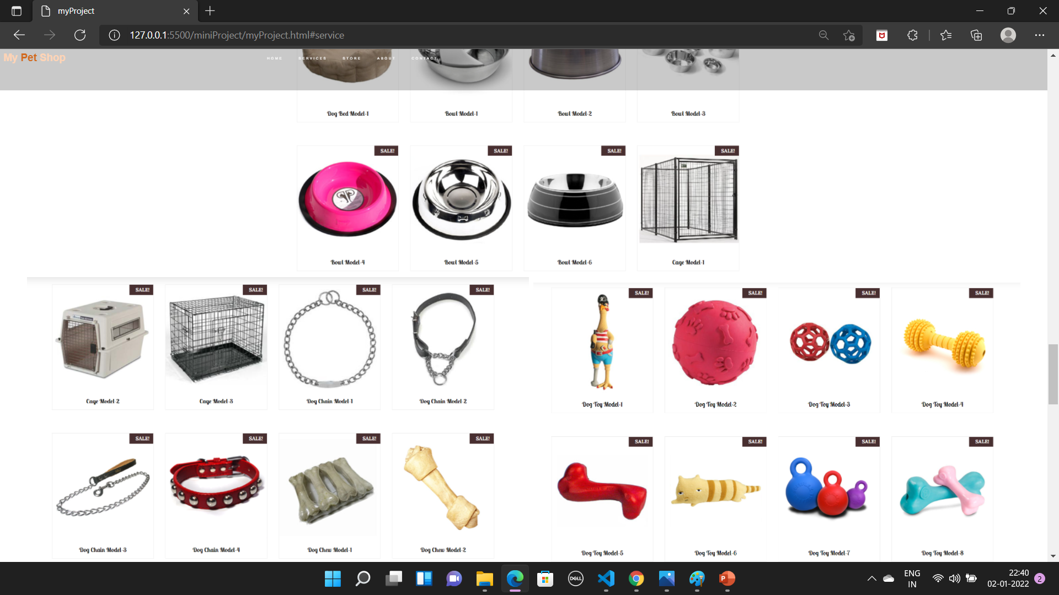
Output Of Store Page

Slide 8
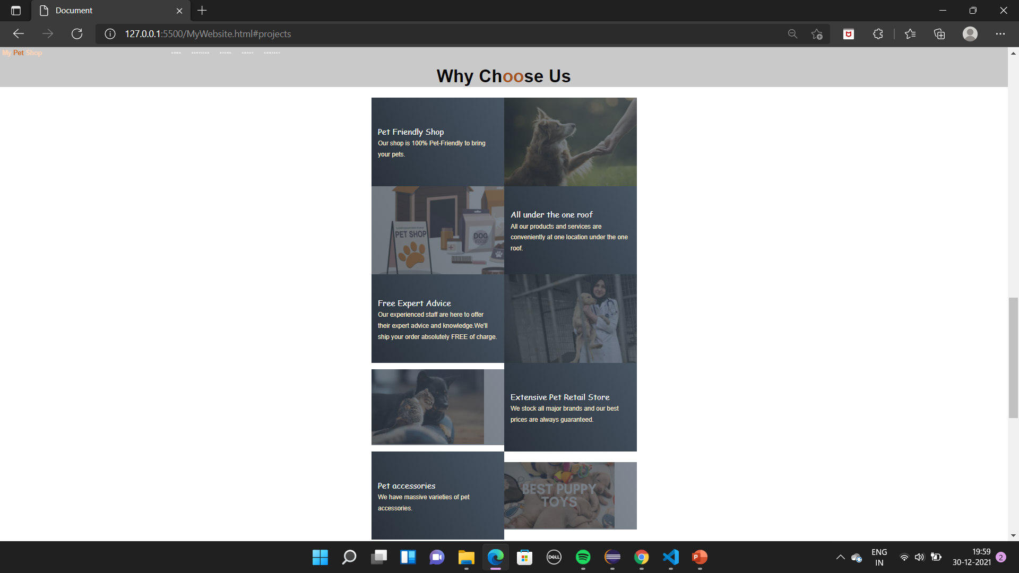
Output Of Store Page

Slide 9
About Page
Description:
In this page, it tells about the store in a short way of paragraph.
It also contain Registration Form to new user and Login form to signed member to order their products.

Slide 10
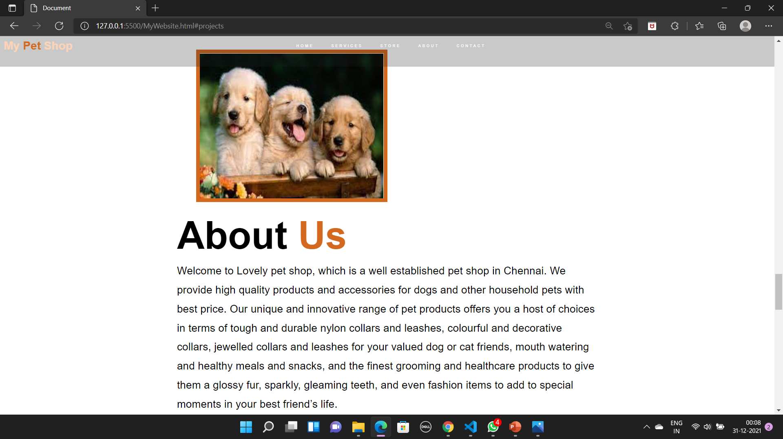
Output Of About Page

Slide 11
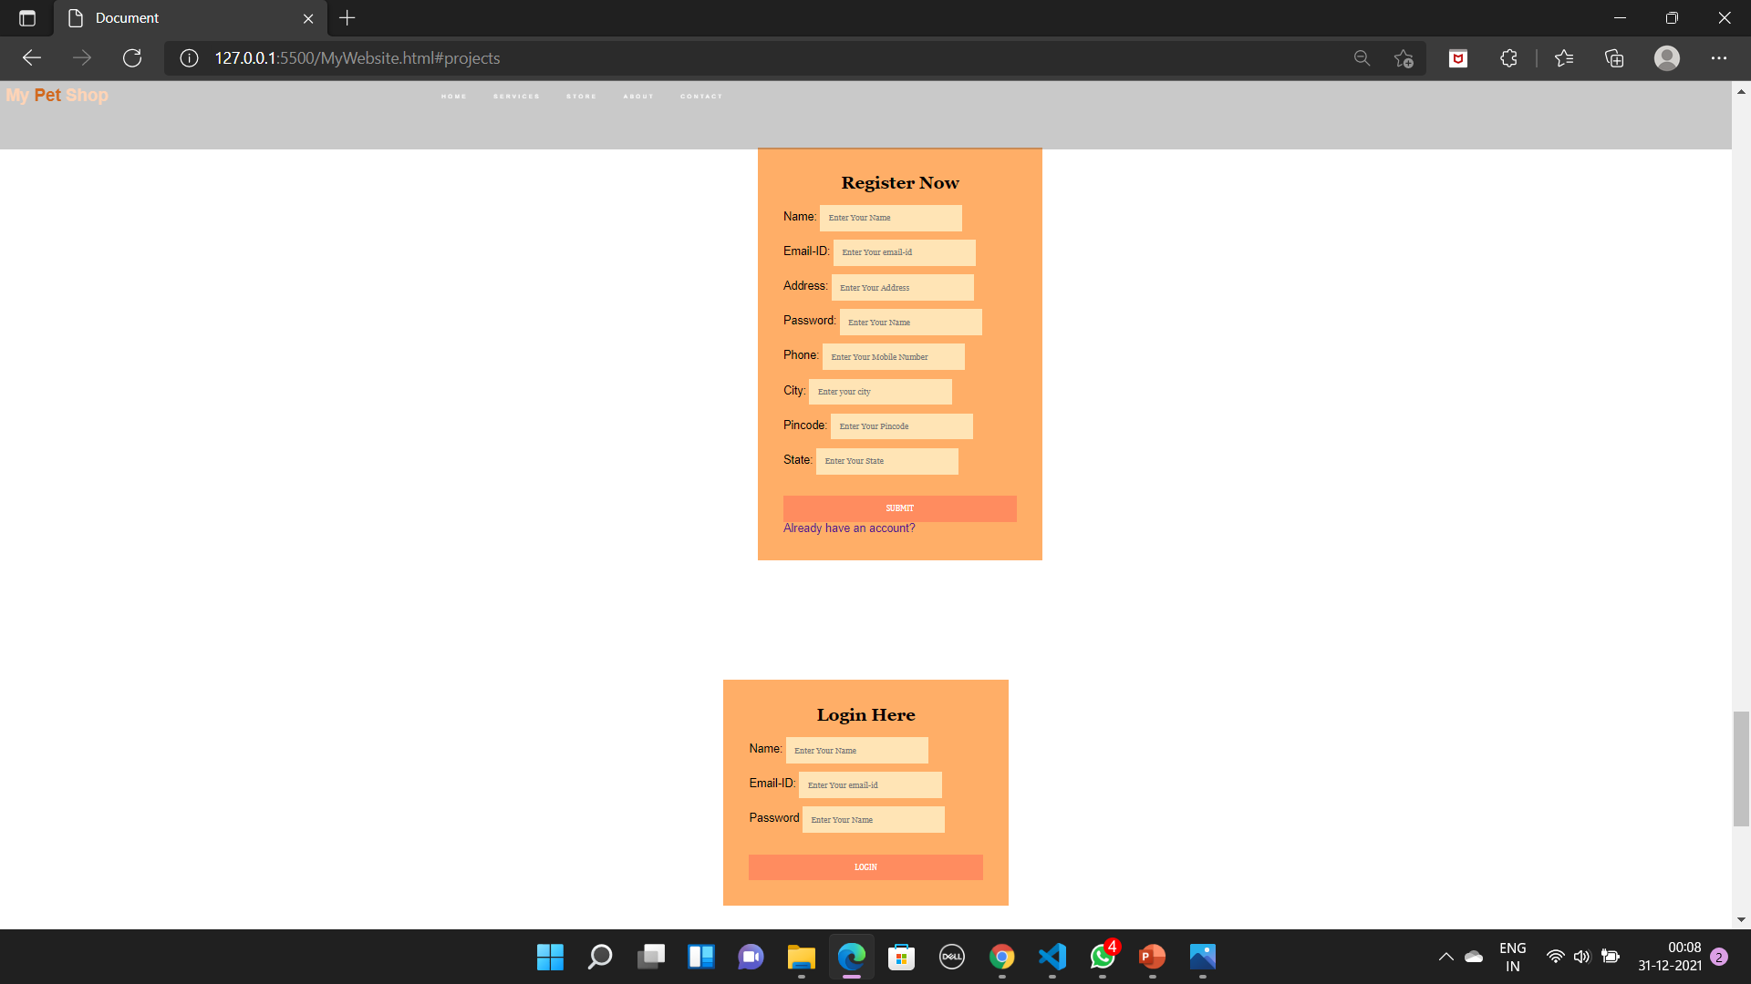
Registration & Login Form

Slide 12
Contact Page
Description:
In this contact page, it contains three items to contact the shop which includes the following sections:
Phone Number
Email-ID
Address

Slide 13
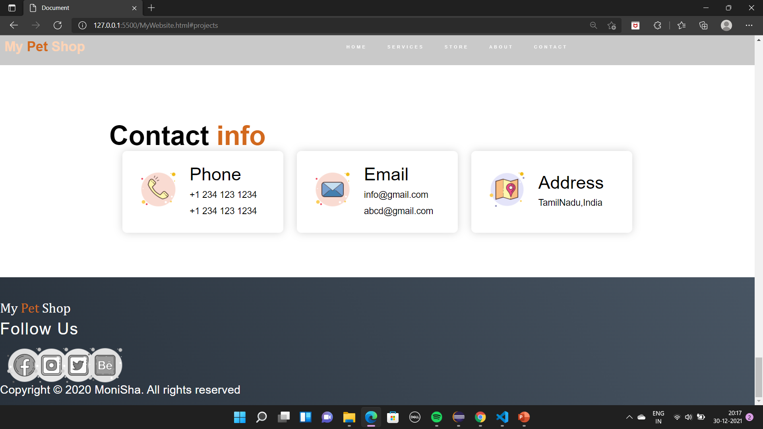
Output of Contact Page

Slide 14
Footer Page
Description:
It includes the contact details like,
Mobile Number
Complete Address
Landline-Number
It also contains the social media link to follow & know more about the shop.
And also includes Copyrights.

Slide 15
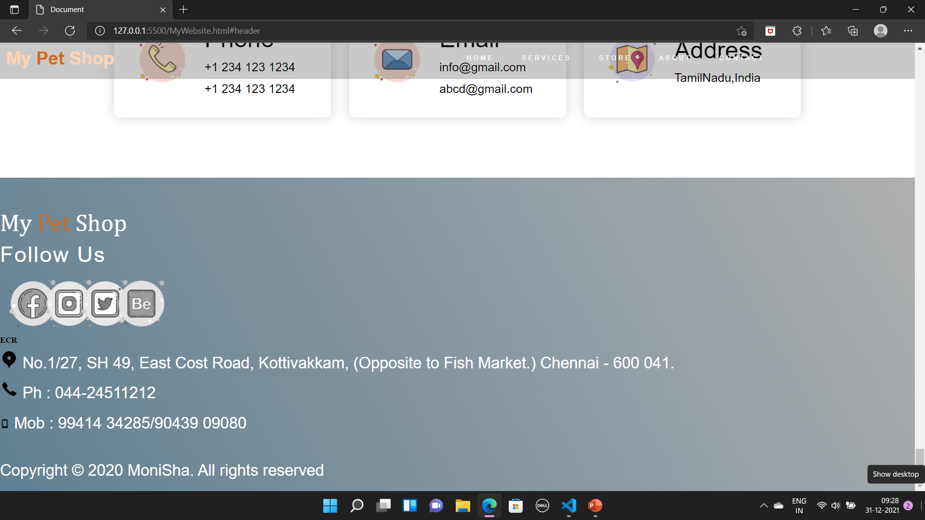
Output Of Footer Page

Slide 16
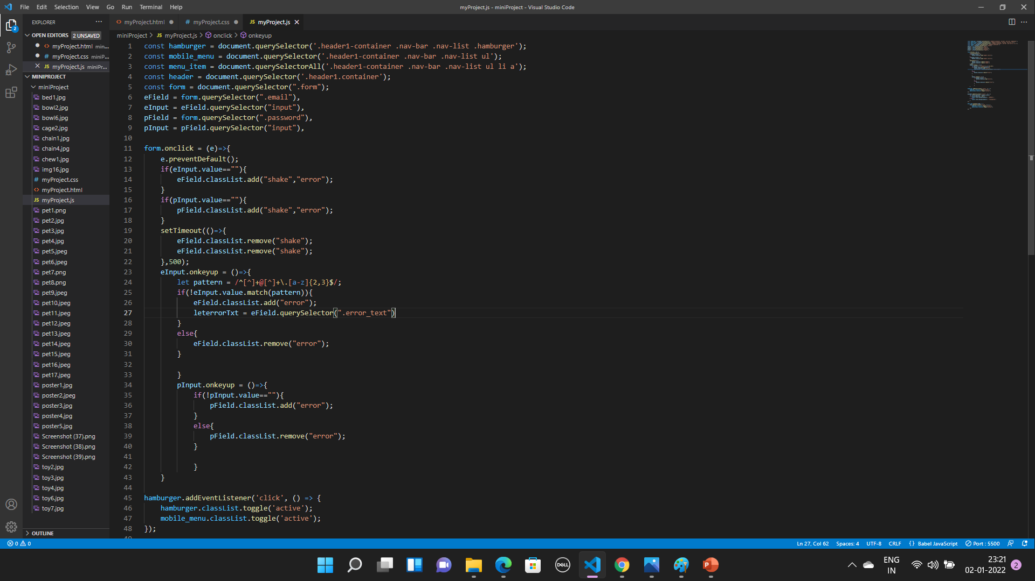
Java Script Page

Slide 17
Media Screen
Description:
It is used to show the webpage without any error even the dimenstions or size will changed to minimized or mobile view.
It includes the sidebar which is placed in top right corner of homepage.
Through the sidebar we can access the other pages as well.

Slide 18
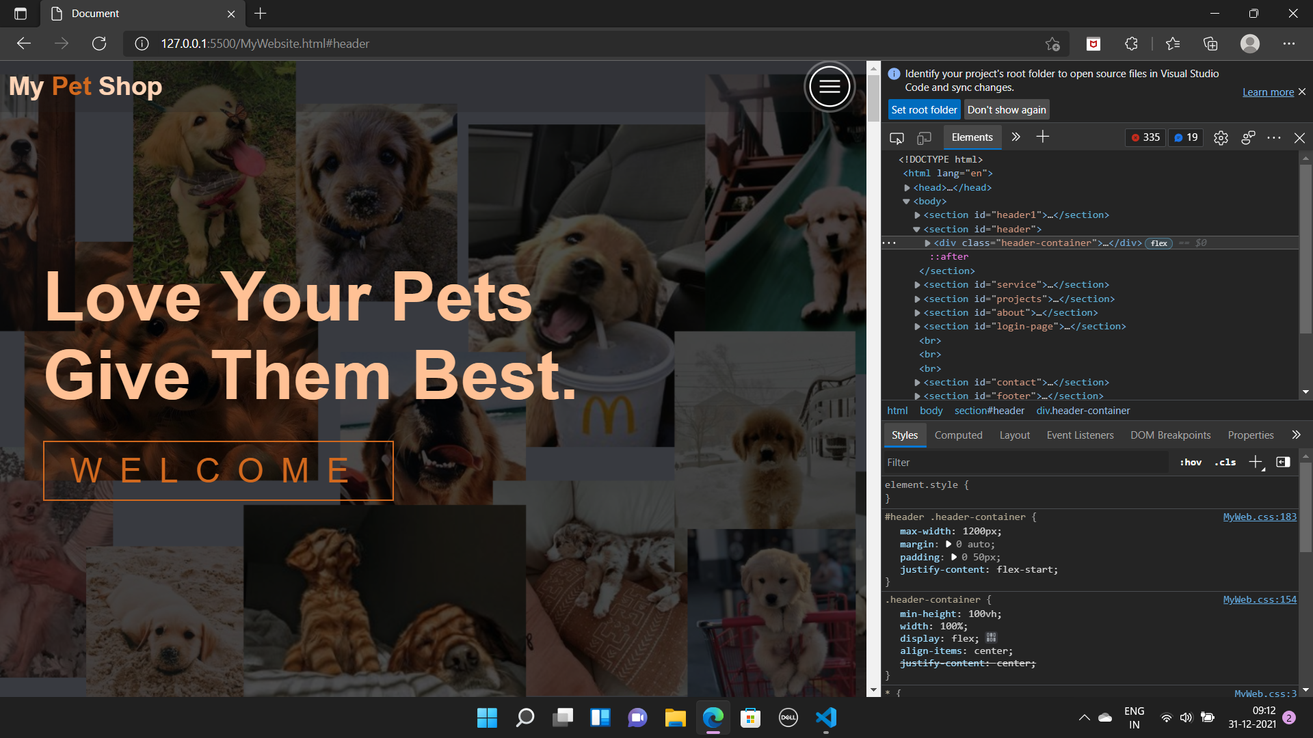
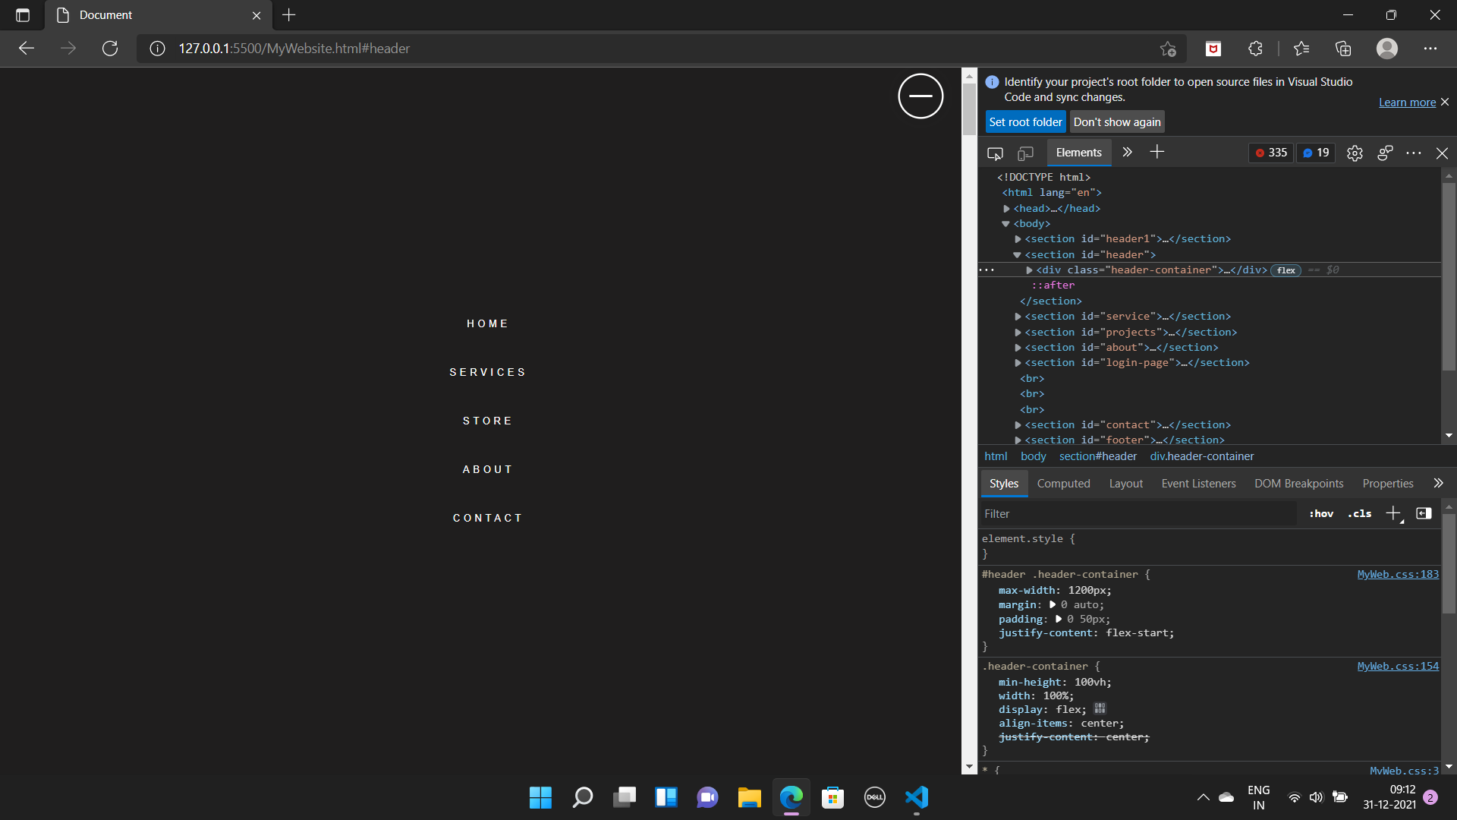
Output Of Media Screen View

Slide 19
THANK YOU

